Slide 1
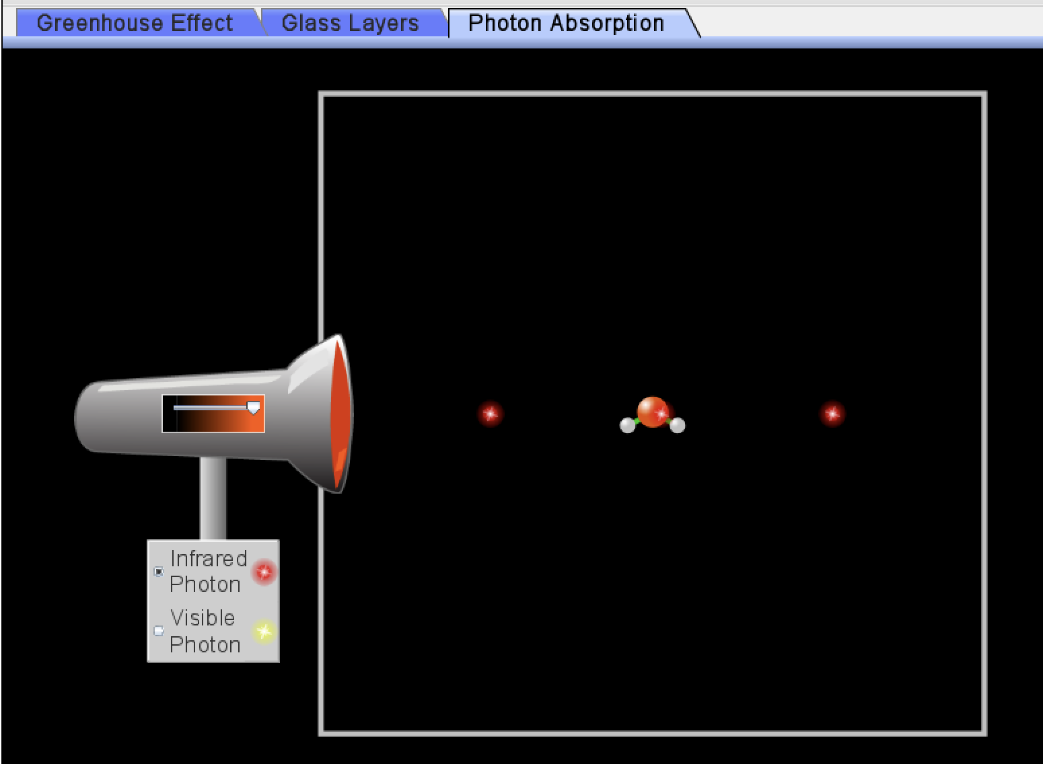
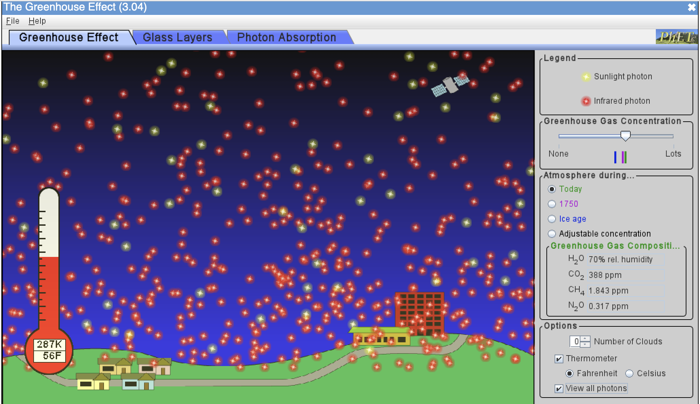
Recap: Let’s talk about the concepts of radiative balance, SW, LW, and homeostasis
What kind of light (SW or LW) do GHG molecules absorb?
What happens to those molecules when they absorb that light?
Assuming radiative balance, why are there more LW photons leaving Earth than SW photons coming in?
What seems to be the homeostatic temperature (in degrees K, C, F) with default settings?
How much colder was it back in 1750 compared to now?
How much colder was it during ice ages compared to now?
What effect do clouds have on SW photons?
On LW photons?
On temperature?
https://phet.colorado.edu/sims/cheerpj/greenhouse/latest/greenhouse.html?simulation=greenhouse

Slide 2
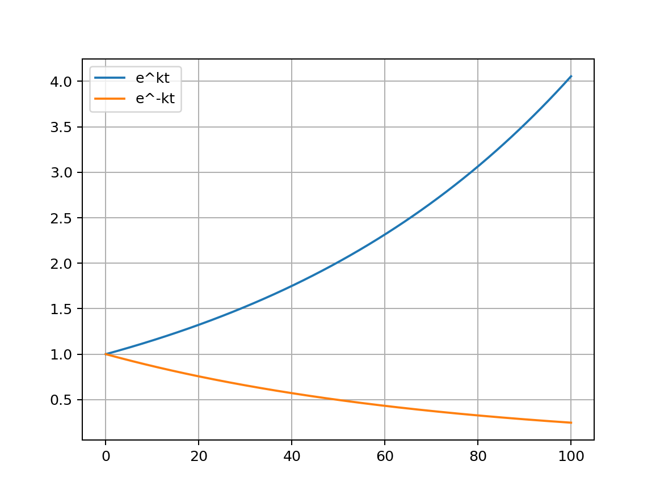
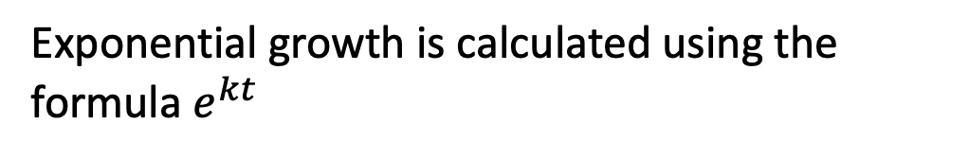

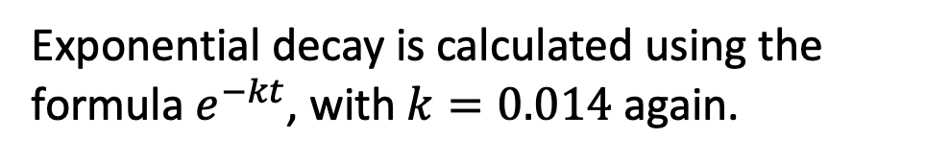
A some vocabulary we’ll need to talk about exponential growth (and decay)
exponential growth
exponential decay
time
time
Notes:
Exponential growth and decay add (or subtract) an amount that is proportional to the current value
Exponential growth increases at an increasing rate as the current value increases
Exponential decay decreases at a decreasing rate as the value decreases
k = 0.014 corresponds to a 1.4% increase or decrease per time step t

Slide 3
A some vocabulary we’ll need to talk about exponential growth (and decay)
Exponential growth has a special quality you can see here:
How long did it take to get from 1 to 2?
exponential growth
time

Slide 4
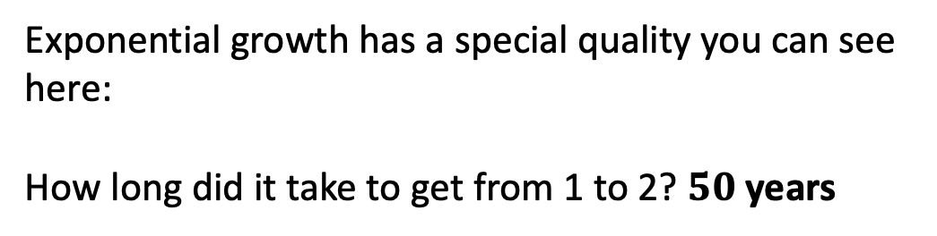
A some vocabulary we’ll need to talk about exponential growth (and decay)
exponential growth
time

Slide 5
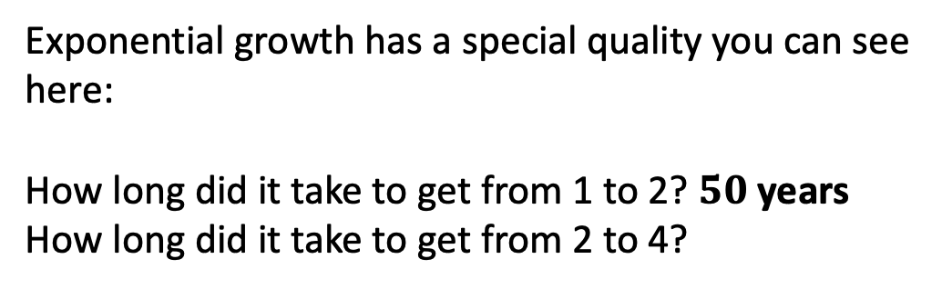
A some vocabulary we’ll need to talk about exponential growth (and decay)
exponential growth
time

Slide 6
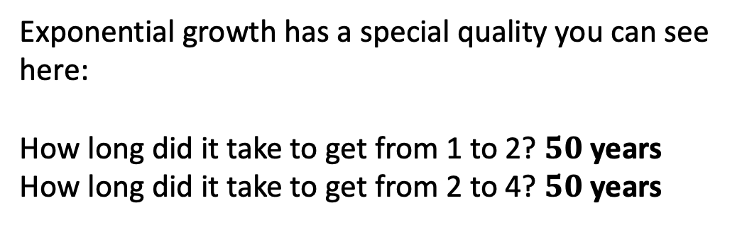
A some vocabulary we’ll need to talk about exponential growth (and decay)
exponential growth
time

Slide 7
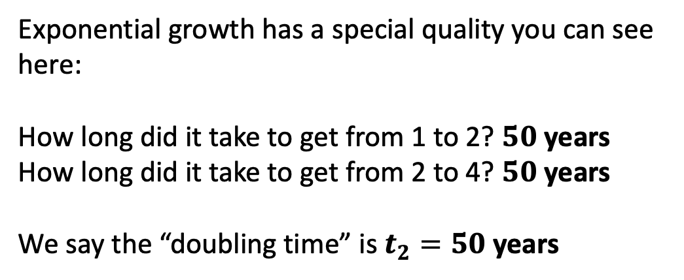
A some vocabulary we’ll need to talk about exponential growth (and decay)
exponential growth
time

Slide 8
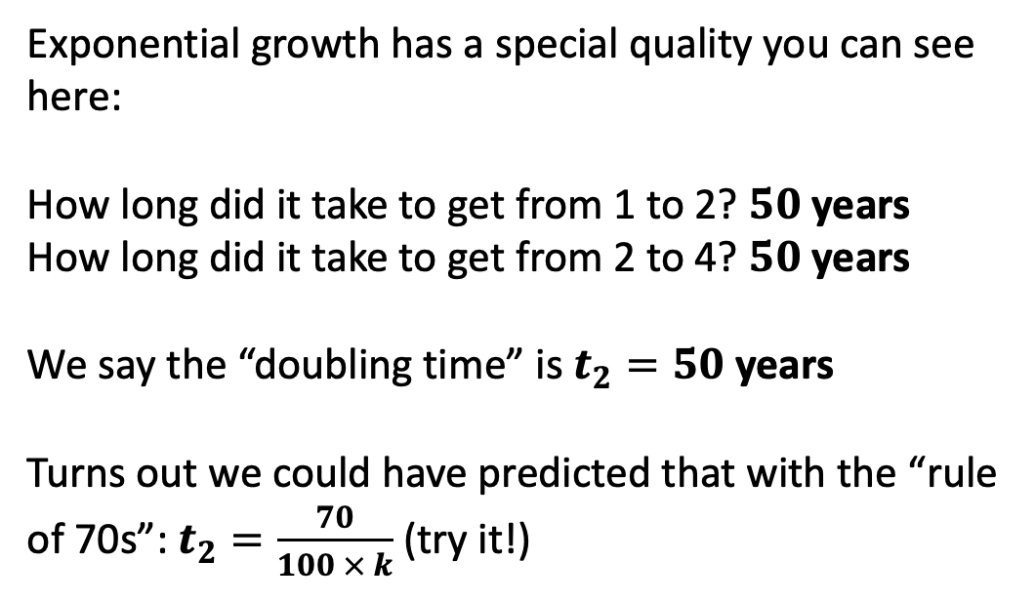
A some vocabulary we’ll need to talk about exponential growth (and decay)
exponential growth
time

Slide 9
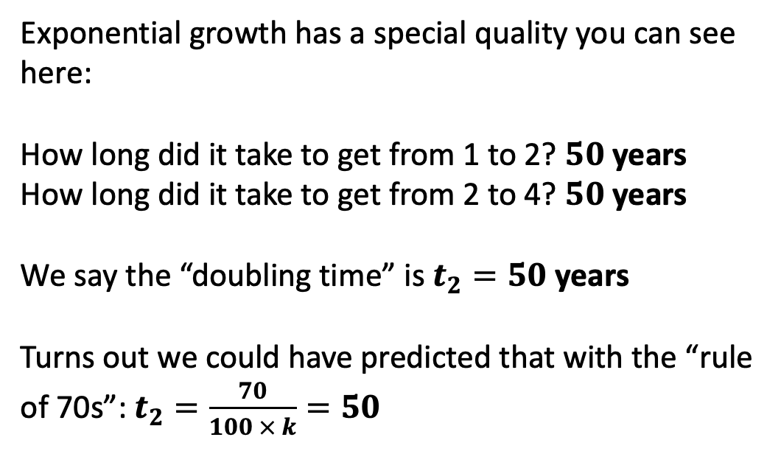
A some vocabulary we’ll need to talk about exponential growth (and decay)
exponential growth
time

Slide 10
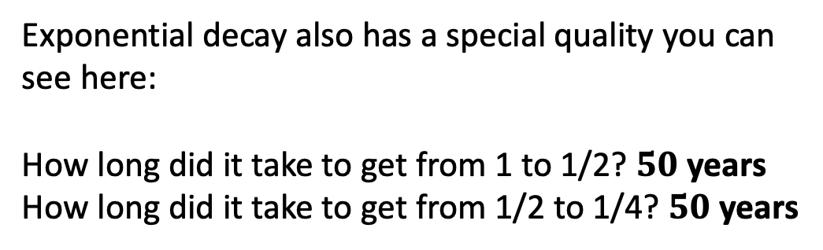
A some vocabulary we’ll need to talk about exponential growth (and decay)
exponential decay
time

Slide 11
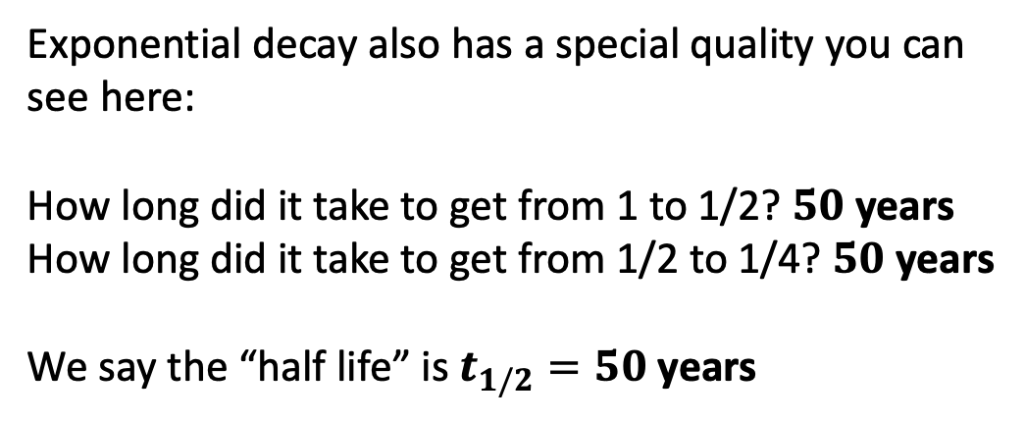
A some vocabulary we’ll need to talk about exponential growth (and decay)
exponential decay
time

Slide 12
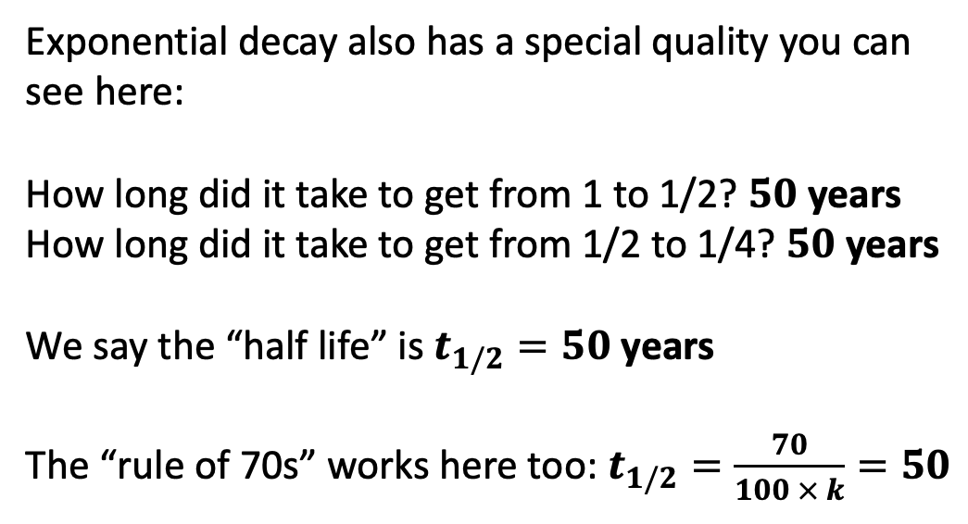
A some vocabulary we’ll need to talk about exponential growth (and decay)
exponential decay
time

Slide 13
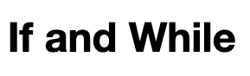
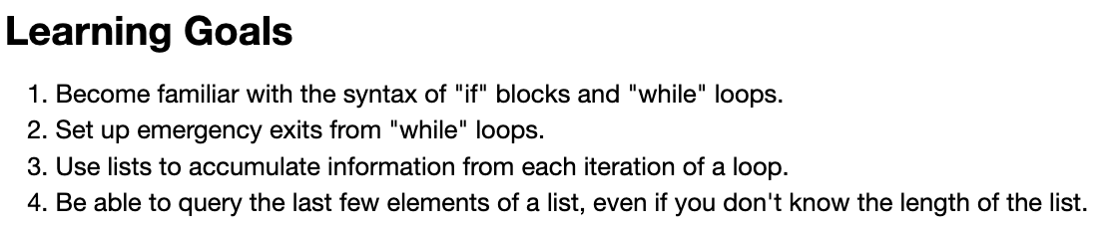
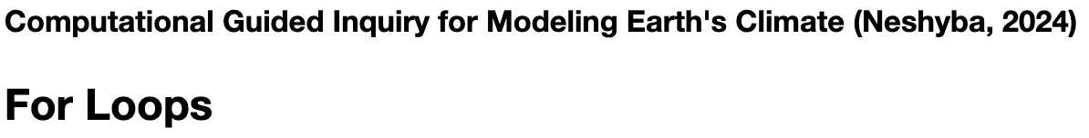
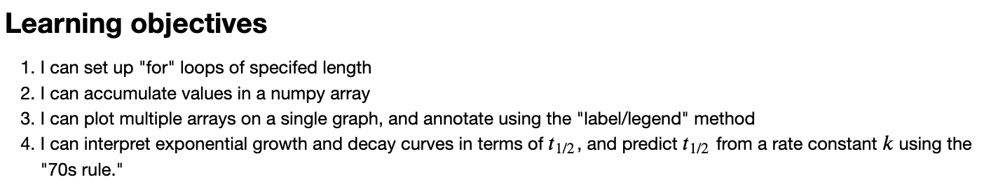
We’ll also need to gain skill in setting up conditional (“If and While”) operations, and how to set up loops (because to simulate the climate we’ll need to loop over time).

